Slide 1
What does the turtle do?
Whenever there is a neighbor not yet traversed, traverse it.
Go back when all the neighbors are traversed.

Slide 2
烏龜心法
只要旁邊還有一個沒走過的點，就走過去
只要旁邊每個點都走過了，就回頭

Slide 3
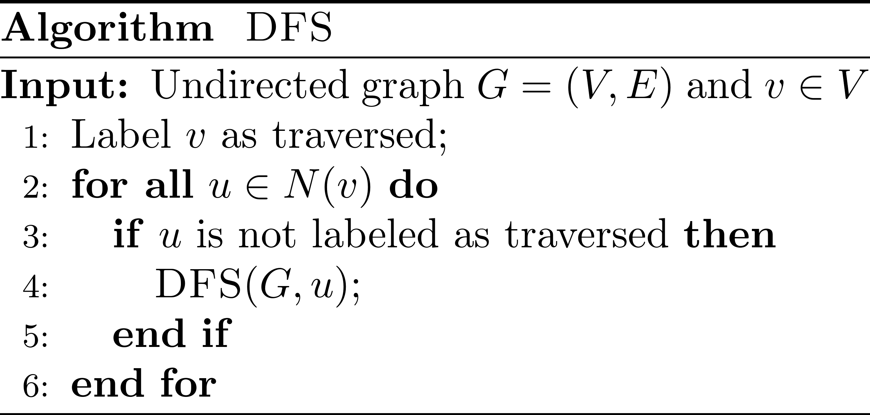
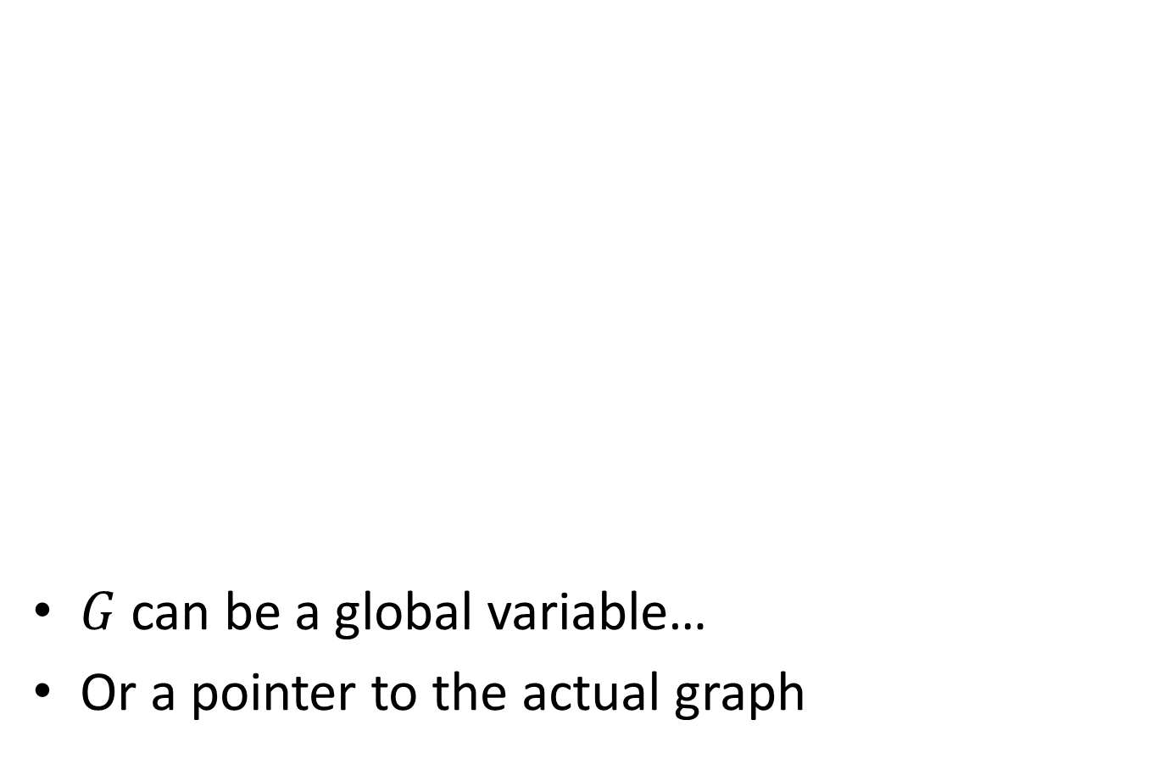
Pseudocode
$G$ can be a global variable…
Or a pointer to the actual graph

Slide 4
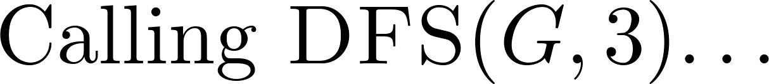
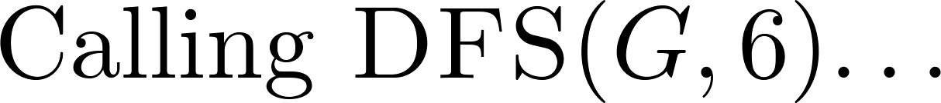
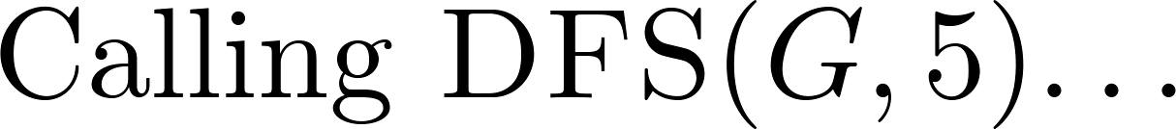
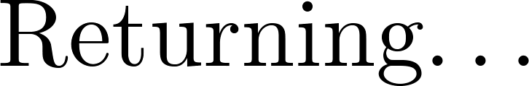
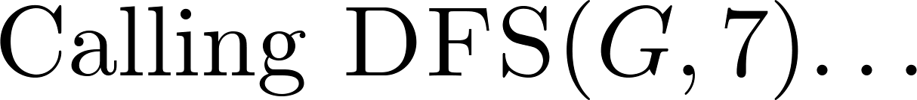
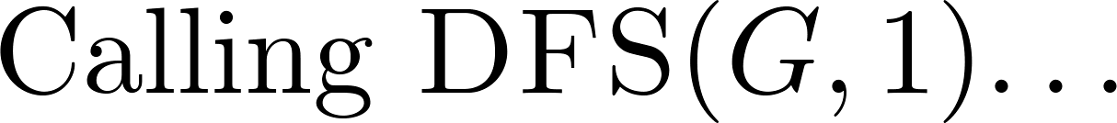
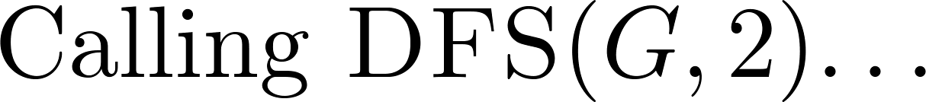
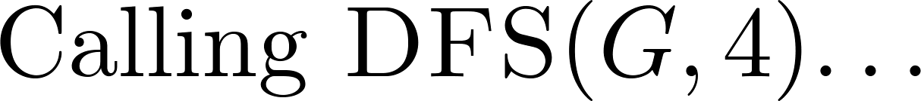
Function calls ☺
3
6, 2, 7
3, 5, 7, 1
6
2
3, 4
5
4
7
6
2
1
1, 3, 6
7, 6

Slide 5
Caller
Callee

